Slide 1


How to attract people to use your data
Dr. Evaezi Okpokoro

Slide 2
Topics to cover
Always cite your data
Publish in a data journal

Slide 3
Always cite your data
What is data citation?
Data citation refers to the practice of providing a reference to data in the same way as researchers routinely provide a bibliographic reference to outputs such as journal articles, reports and conference papers. Citing data is now recognized as one of the key practices leading to recognition of data as a primary research output.
https://www.ands.org.au/working-with-data/citation-and-identifiers/data-citation

Slide 4
Always cite your data
Why cite your data?
Evidence suggests that citing data in related publications increases the citation rate of those publications
Routine citation of data acknowledges data as a first class research output and facilitates reproducible and transparent research
Citations for published data can be included in CVs and biographical sketches along with journal articles, reports and conference papers
Only cited data can be counted and tracked (in a similar manner to journal articles) to measure impact.

Slide 5
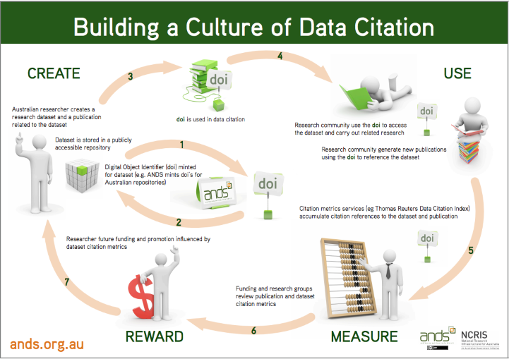
Always cite your data

Slide 6
Always cite your data
Use of Digital Object Identifier
Persistent identifiers ensure future access to unique published digital objects, such as a text or data set. Persistent identifiers are assigned to data sets by digital archives
Watch video
https://youtu.be/PgqtiY7oZ6k

Slide 7
How to cite your data
A standard citation includes the following elements (* = if applicable):
Creators (Publication Year): Title. Version*. Publisher. DOI*
Example
Hanigan, Ivan (2012): Monthly drought data for Australia 1890-2008 using the Hutchinson Drought Index. The Australian National University Australian Data Archive. http://doi.org/10.4225/13/50BBFD7E6727A
Jansen, J. (Erasmus University Rotterdam) (2017): Foreign-born Olympic athletes 1948 - 2012. DANS. https://doi.org/10.17026/dans-2xf-pyqp

Slide 8
Publish in a data journal or archive in institutional repositories
Why publish your data
Consider publishing an article in a peer-reviewed data journal. Data journals are designed to comprehensively document and publish deposited datasets and to facilitate their online exploration

Slide 9
Data journals
These focus on the dataset rather than research article and provide details such as
the context of the data collection
the choice of software environment
data processing decisions including file formats.
no analysis but rather they provide a mechanism for describing and the data and its accessibility while also providing a means to credit the data creators through citation and peer-review.

Slide 10
Data journals
Examples of data journal
Research Data Journal for the Humanities and Social Sciences (RDJ, Brill, 2017);
Journal of Open Psychology Data (JOPD, Ubiquity Press, n.d.a);
Journal of Open Archaeology Data (JOAD, Ubiquity Press, n.d.b);

Slide 11
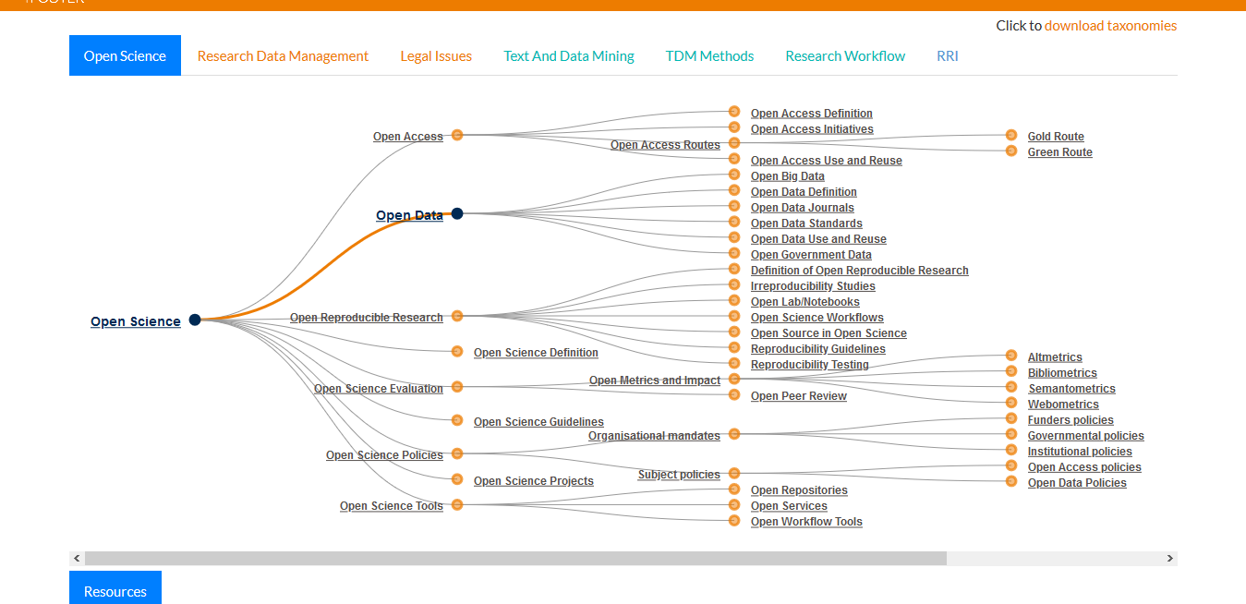
Examples of data journals

Slide 12
Acknowledgement
Colleagues
Temi
Tope
Osas
Maryam
Kyusonn
Funding
European Developing Countries Trial Partnership (EDCTP)
WHO/TDR re-integration
Alash’le Abimiku- through IRCE

Slide 13
Thanks for listening
Questions?

